Slide 1

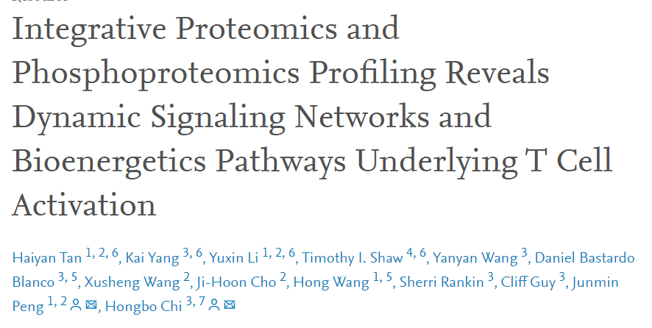
REPORT
STUDENT NAME: TIANXIA SONG
STUDENT NUMBER: 20211716

Slide 2

01
Main aim
02
Work completed
CONTENTS
03
Weaknesses and Improvements
04
Discussion and
Future
05
References

Slide 3
Main aim
01

Slide 4

1.Main aim
The goal is to understand, recapitulate and provide a critical analysis of the pipeline.

Slide 5
Work completed
02

Slide 6
Work completed
Trend Clustering
Understood the significance of statistical values
ANOVA
Limma
A
B
C
D

Slide 7
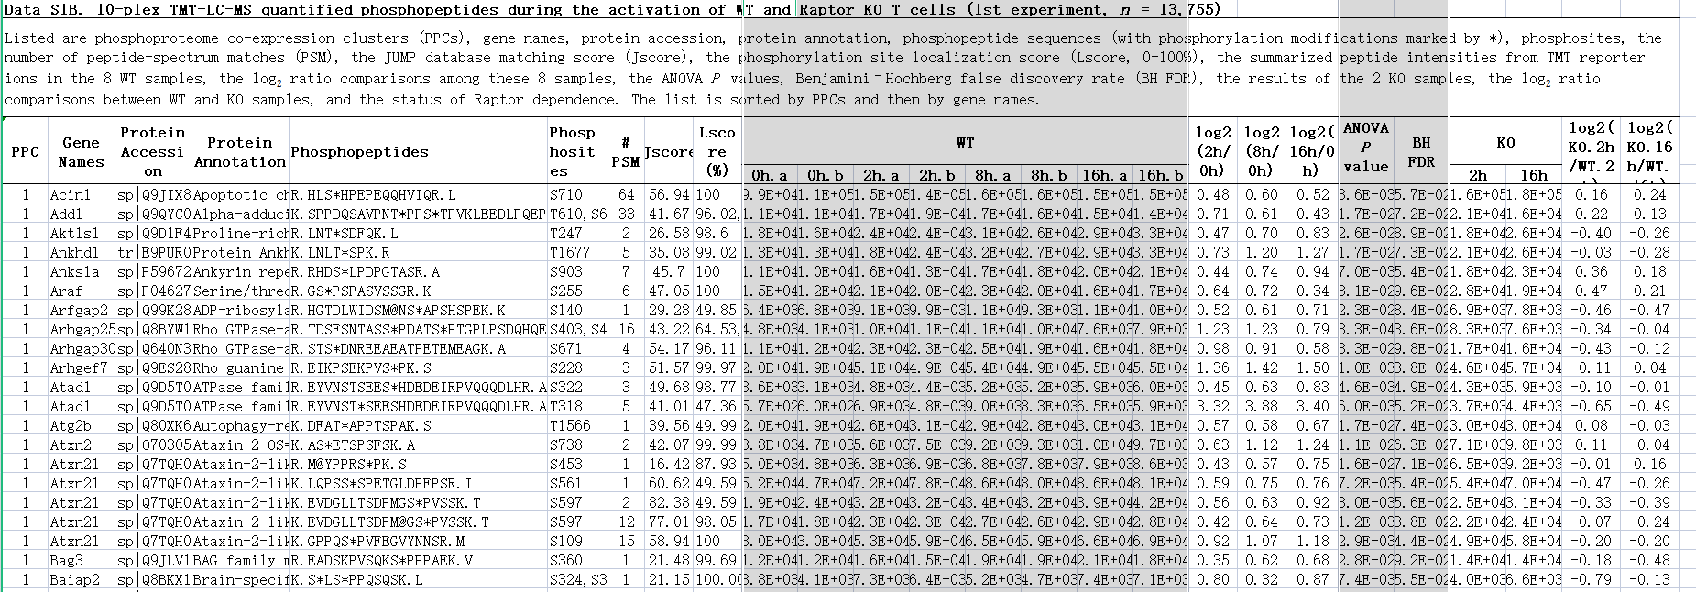
Trend Clustering
A
2.Work completed

Slide 8

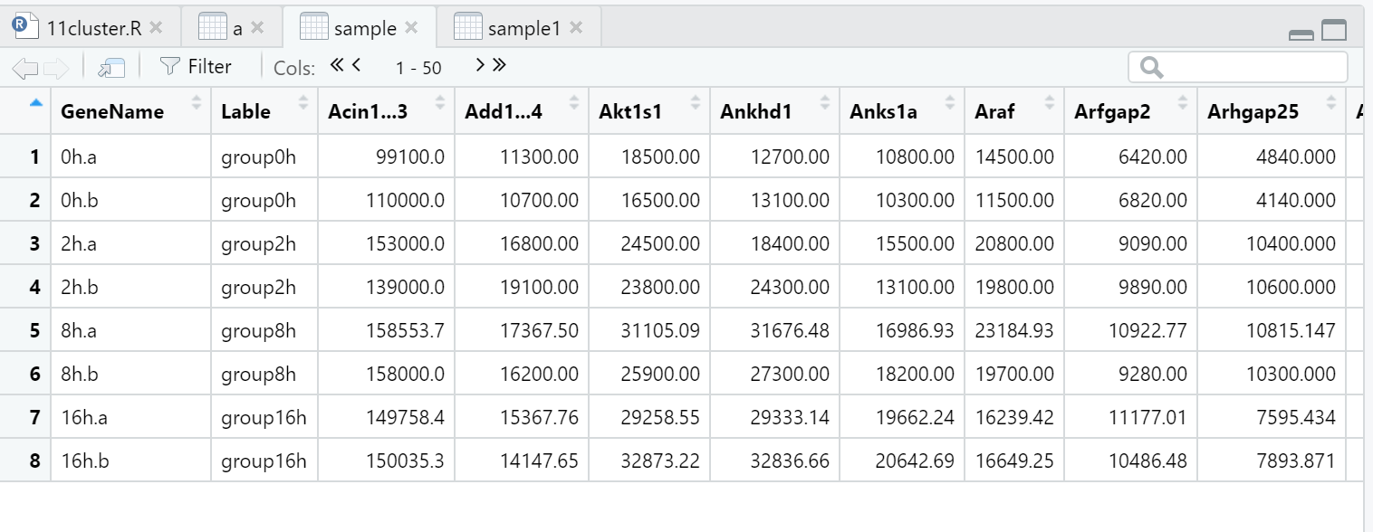
Trend Clustering
A
2.Work completed

Slide 9
Trend Clustering
A
2.Work completed

Slide 10
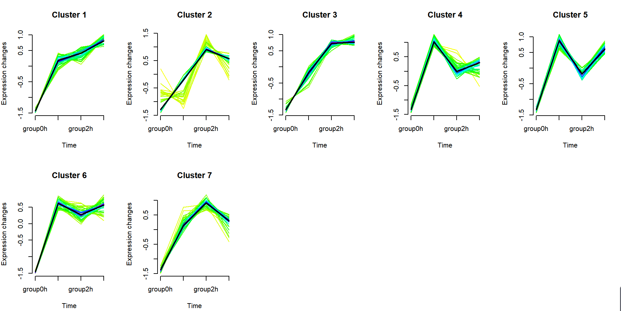
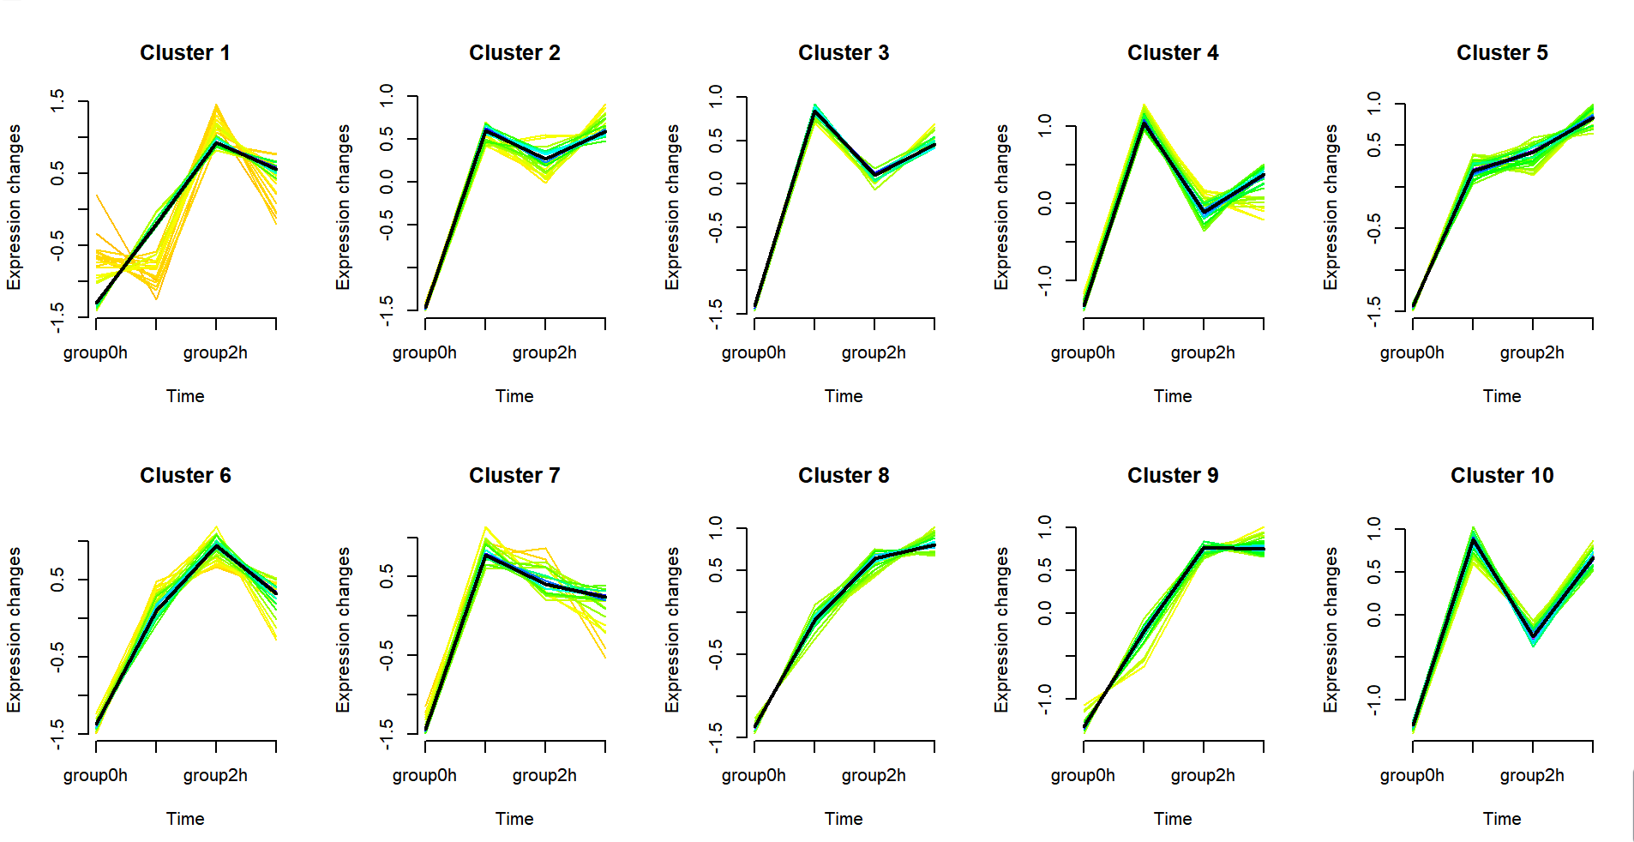
Trend Clustering
A
2.Work completed

Slide 11




Understood the significance of statistical values
B
2.Work completed
LogFC
Fold change

Slide 12
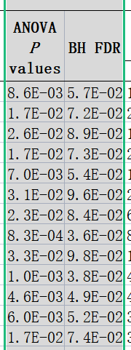
Understood the significance of statistical values
B
2.Work completed
Fold change
LogFC

Slide 13
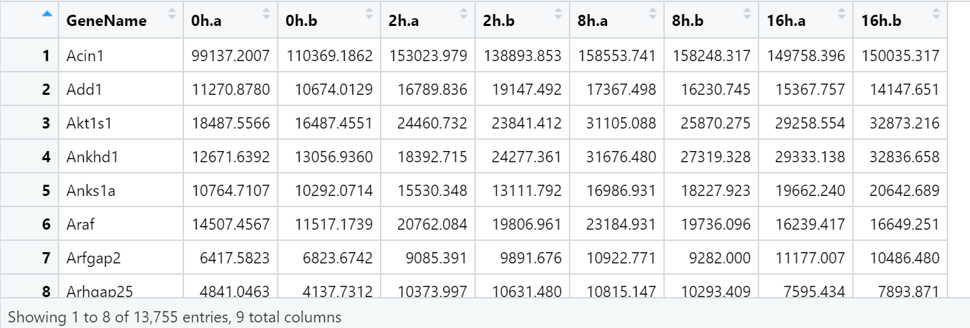
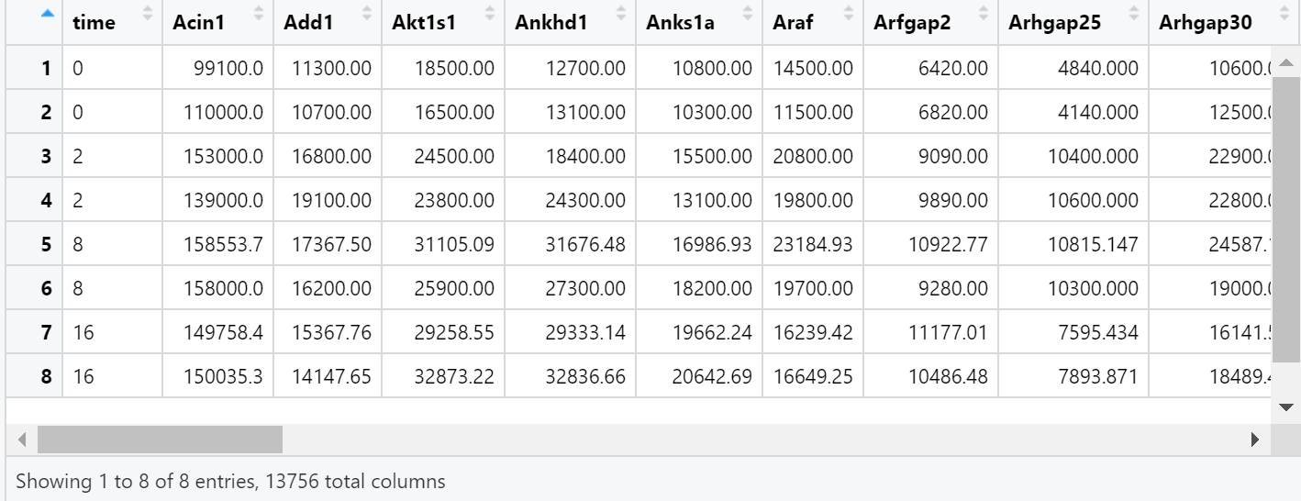
ANOVA
C
2.Work completed

Slide 14
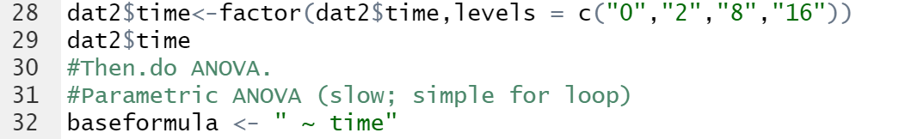
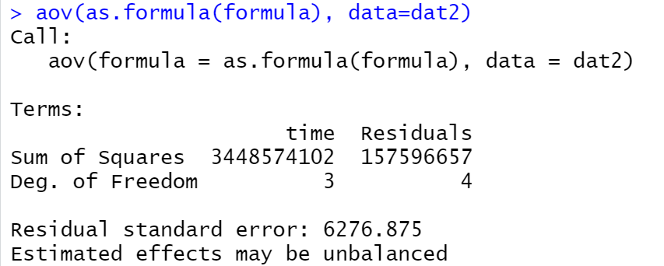
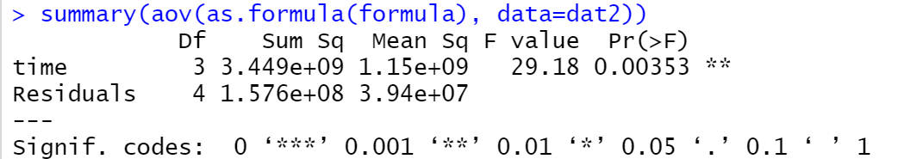
ANOVA
C
2.Work completed

Slide 15
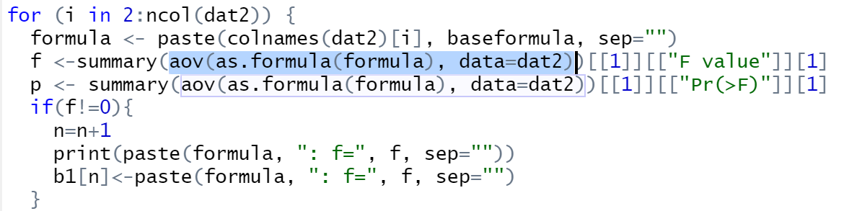
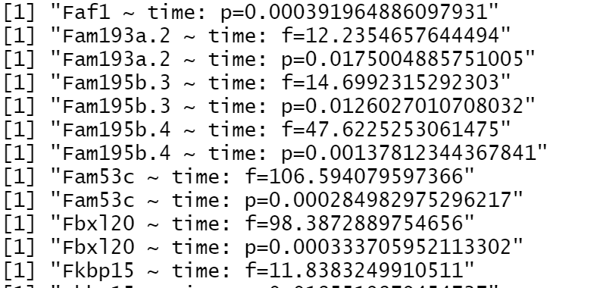
ANOVA
C
2.Work completed

Slide 16
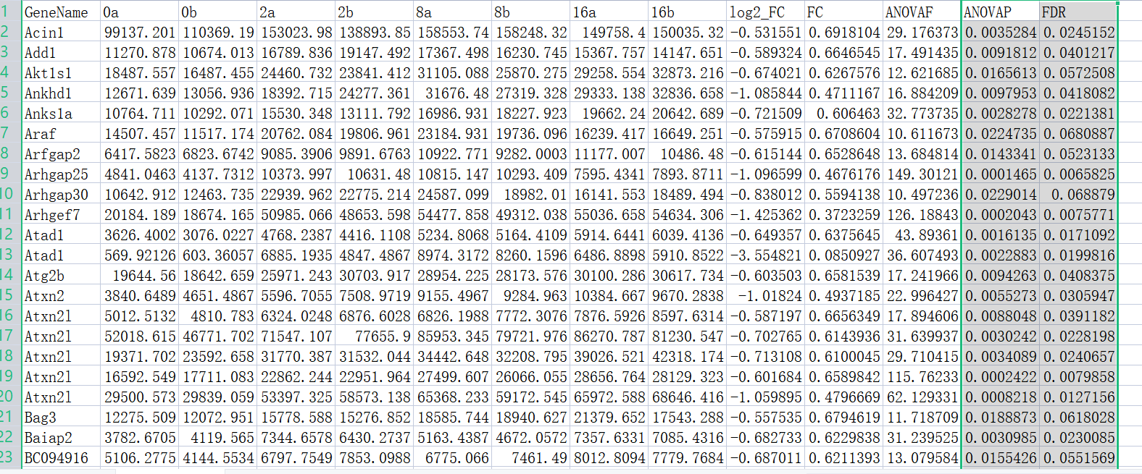
ANOVA
C
2.Work completed

Slide 17
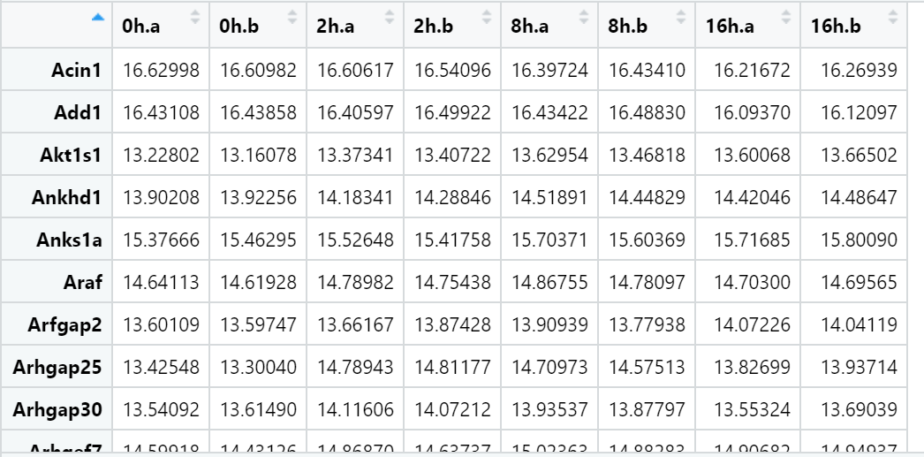
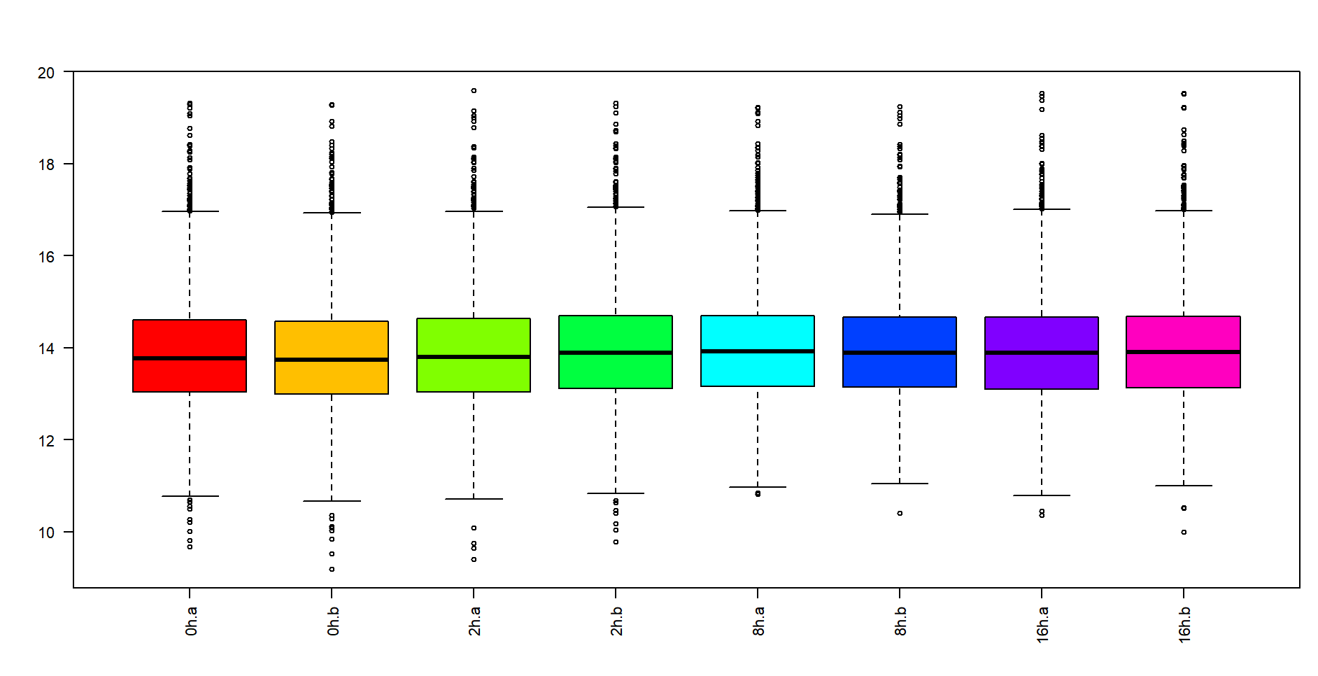
Limma
D
2.Work completed

Slide 18
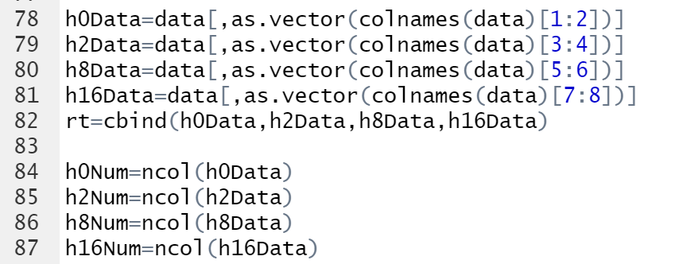
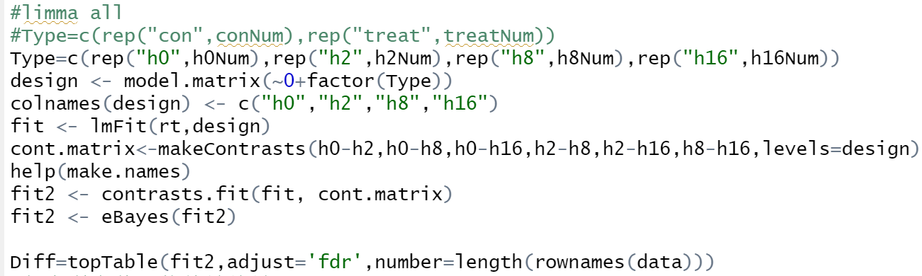
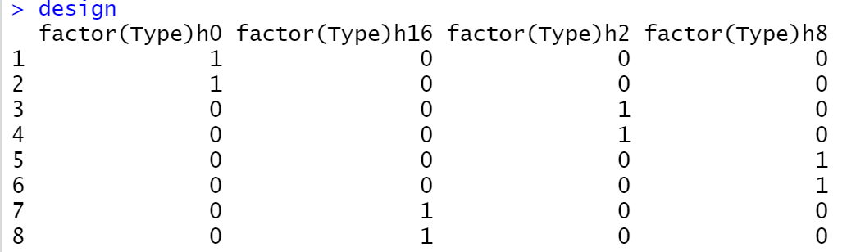
Limma
D
2.Work completed

Slide 19
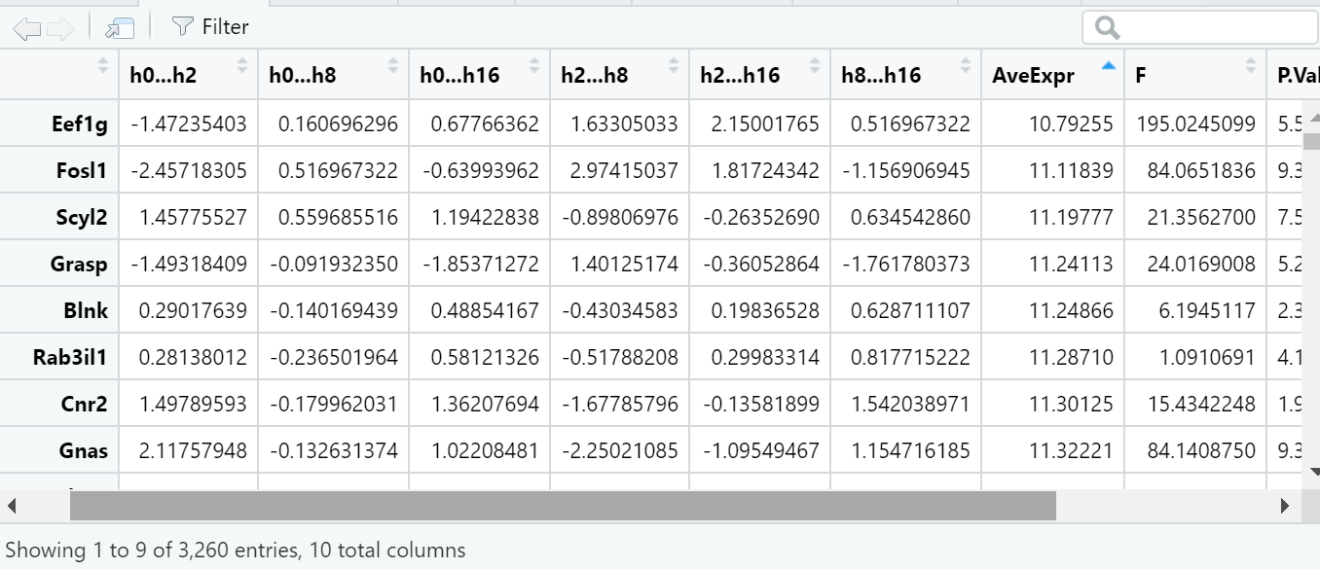
Limma
D
2.Work completed

Slide 20
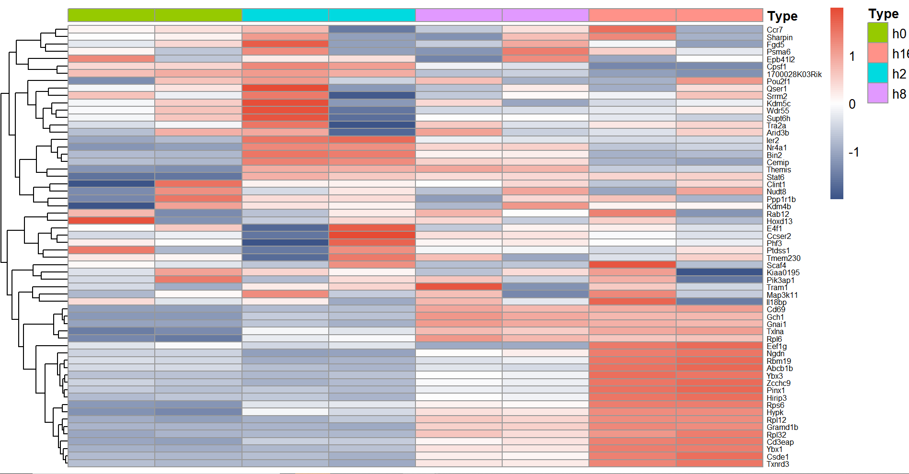
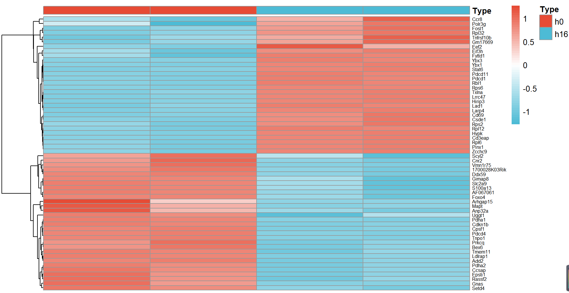
Limma
D
2.Work completed

Slide 21
Weaknesses and Improvements
03

Slide 22
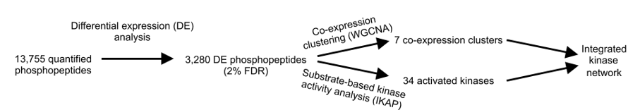
3.Weaknesses and Improvements
Process of DE:
1.ANOVA F-statistic (defined as the ratio of between-group variance to within-group variance)
2.ANOVA Pvalue
3.Benjamini- hochberg (BH) method Correction Test p-value (p<0.1)
4.> 1.5 fold change (Fold change is the difference between two groups, so it needs to be compared between two groups)

Slide 23
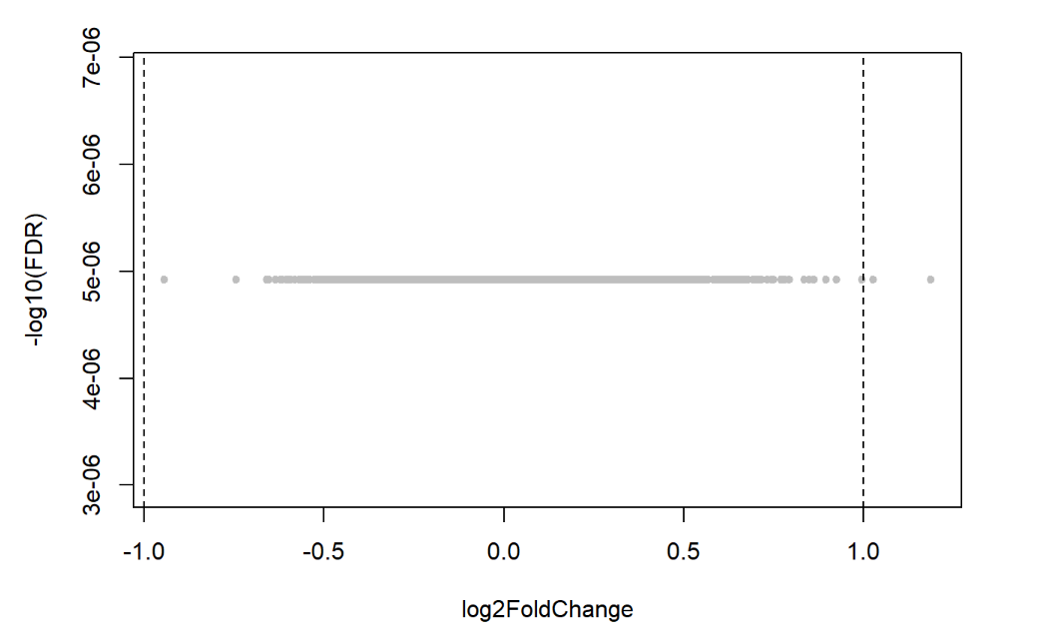
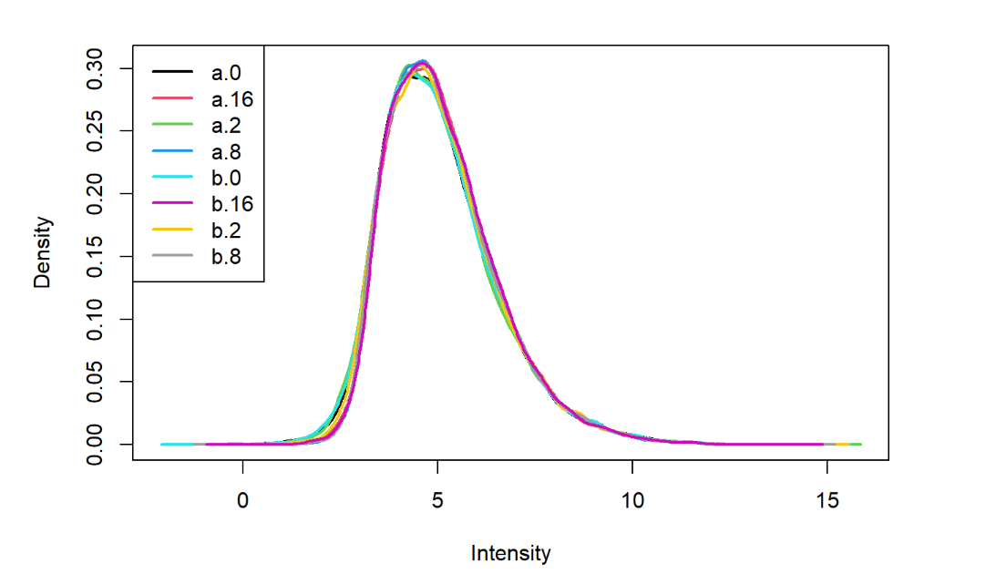
3.Weaknesses and Improvements

Slide 24
Discussion and Future
04

Slide 25

4.Discussion and Future
At the knowledge level
Learned some statistics and understood more deeply the analysis of variance of two groups and more than two groups.
A deeper understanding of limma and ANOVA.
At the technical level
learned more about R
FUTURE
WGCNA and IKAP

Slide 26
Reference
05

Slide 27
5.Reference
Tan, H., Yang, K., Li, Y., Shaw, T.I., Wang, Y., Blanco, D.B., Wang, X., Cho, J., Wang, H., Rankin, S., Guy, C., Peng, J. & Chi, H. 2017, "Integrative Proteomics and Phosphoproteomics Profiling Reveals Dynamic Signaling Networks and Bioenergetics Pathways Underlying T Cell Activation", Immunity (Cambridge, Mass.), vol. 46, no. 3, pp. 488-503.

Slide 28
THANK YOU!

